Slide 1
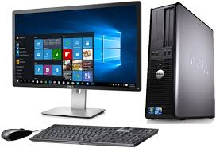
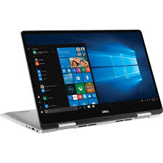
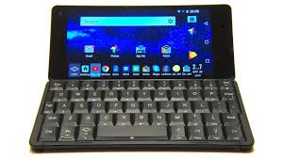
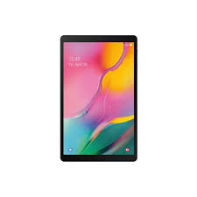
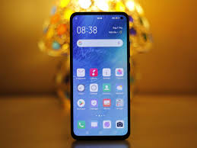
What are Microcomputers

Slide 2
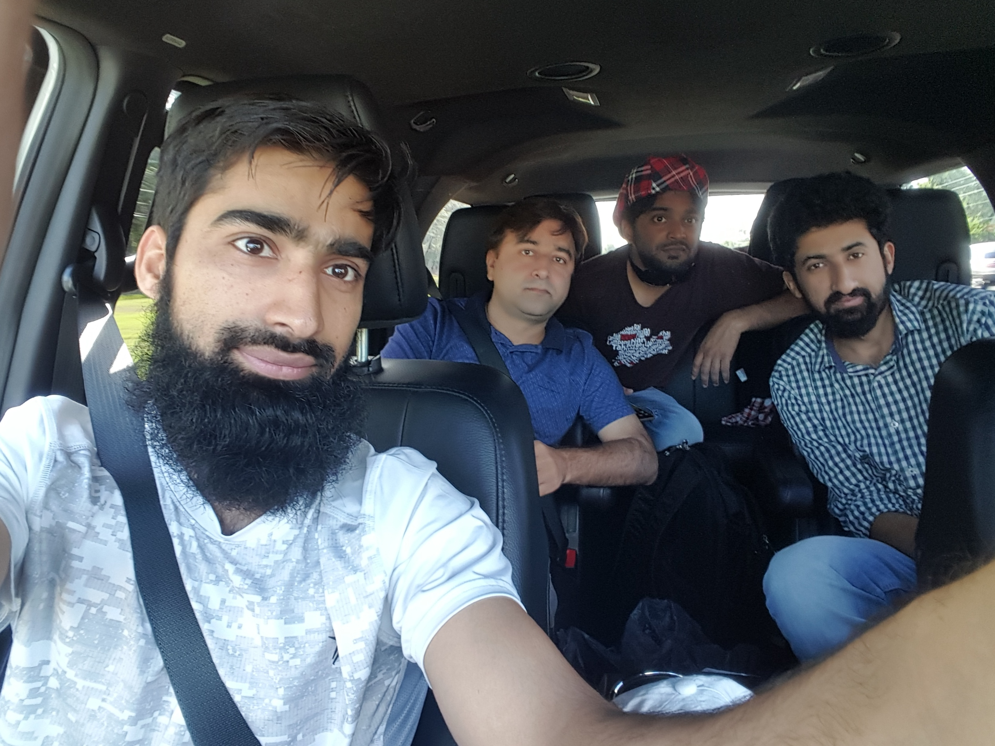
Dr. Sajid Iqbal
Department of Computer Science
Bahauddin Zakariya University, Multan

Slide 3
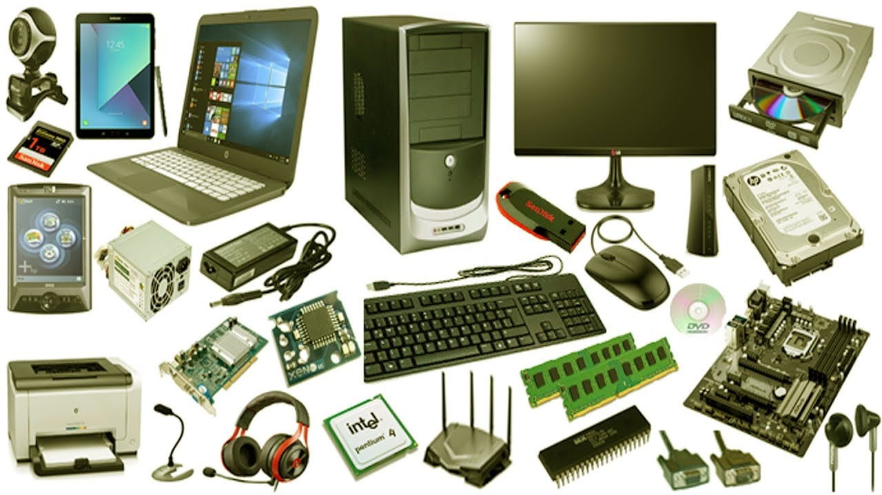
Computer Hardware
Introduction to computers

Slide 4
Lecture Contents
Computer Categorization Schemes
What are micro Computers
Desktop, Laptop, Tablet and Smart Phone
Embedded Computers
Internet of Things (IoT)
Wearable Computers
Computers inside Biological Body
Future Computers

Slide 5
Types of Computers
Computer
Based on type of data processed
Purpose on Use
Size of Processing Capability
Analog Computer
Digital Computer
Hybrid Computer
General Purpose Computer
Special Purpose Computer
Mainframe Computer
Mini Computer
Micro Computer
Super Computer
Wearable Computers
Micro Comptuers
Workstations
Desktop Computer
Laptop Computer
Tablets
Mobile Computer
Embedded Computers

Slide 6
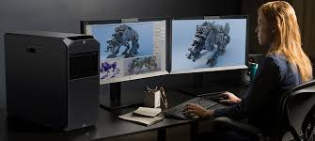
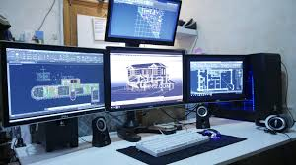
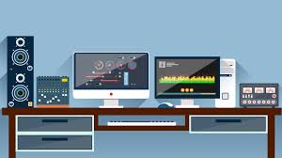
Micro Computers
It is a small, relatively inexpensive computer with a microprocessor as its central processing unit
With the passage of time micro-computers are replacing other big giants
Workstations
A workstation is a special computer designed for technical or scientific applications
Workstations offer higher performance than mainstream personal computers in terms of
CPU and graphics, memory capacity, and multitasking capability
Workstations are optimized for the visualization and manipulation of different types of complex data such as
3D mechanical design,
engineering simulation (e.g., computational fluid dynamics)
animation and rendering of images, and
mathematical plots
However the distinction line has been blurred with increasing capabilities of PCs

Slide 7
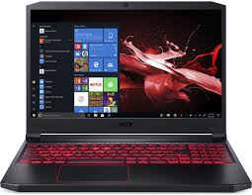
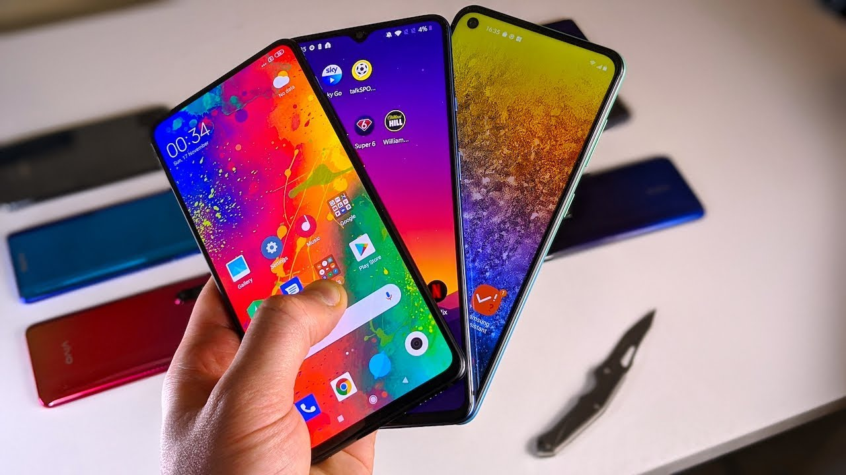
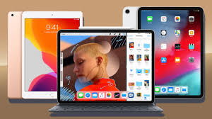
Microcomputers
Desktops
Laptops
Tablets
Smart phones

Slide 8
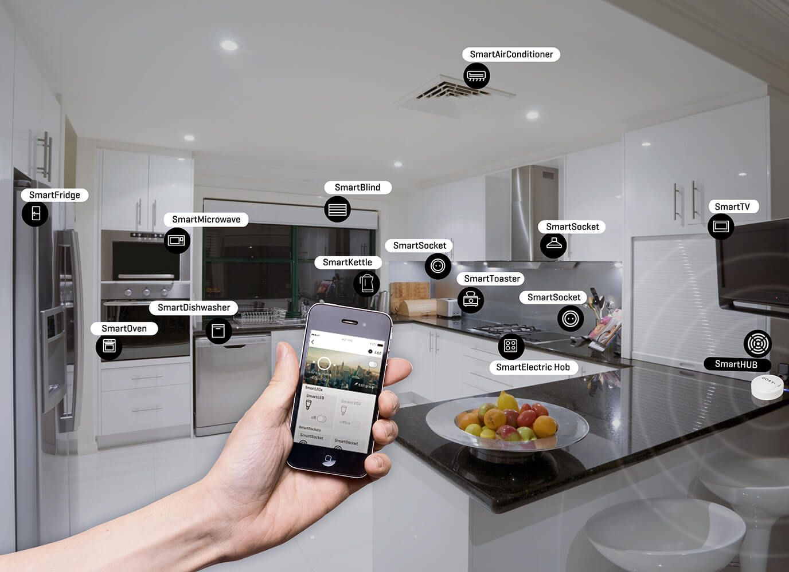
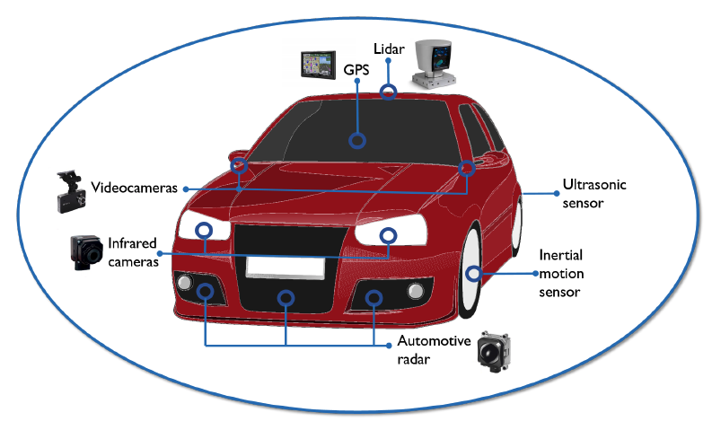
Embedded Computers (IoT)
An embedded computer (micro controller) is a computer that is integrated into other devices
It is dedicated to the functions of that device
Embedded computers are being used in
modern TV sets,
motor vehicles,
telephones,
digital cameras,
washing machines,
microwaves
dishwashers.
The embedded computer is devoted to performing specific tasks
Uses: It is used in communication, entertainment, science and technology…

Slide 9
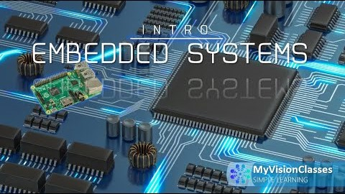
Embedded Systems
Thanks to YouTube video provider

Slide 10
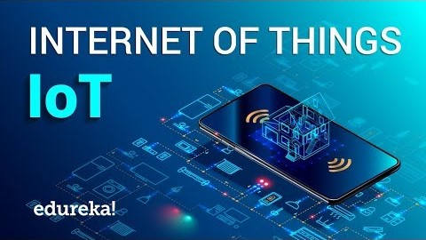
Internet of Things
Thanks to YouTube video provider

Slide 11
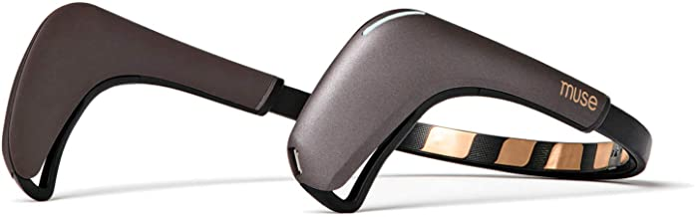
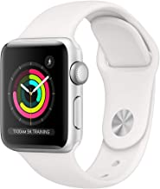
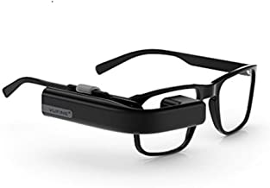
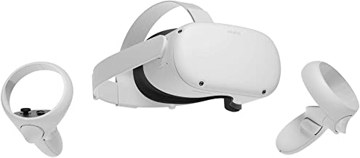
Wearable Computers
A computing device that can be worn on body
Wearable computers are examples of mobile computing
Usually they are special purpose computation devices
Fitness trackers
Heart rate monitors
Thermometers

Slide 12
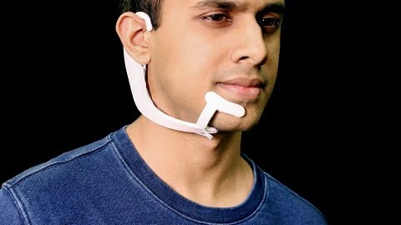
Wearable Computers
Thanks to YouTube video provider

Slide 13
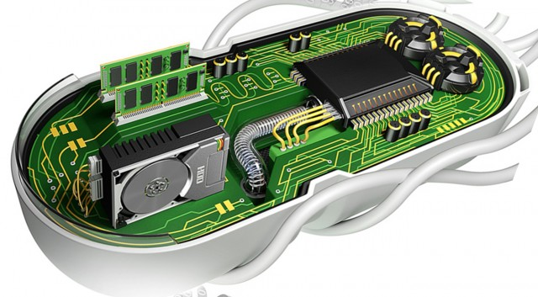
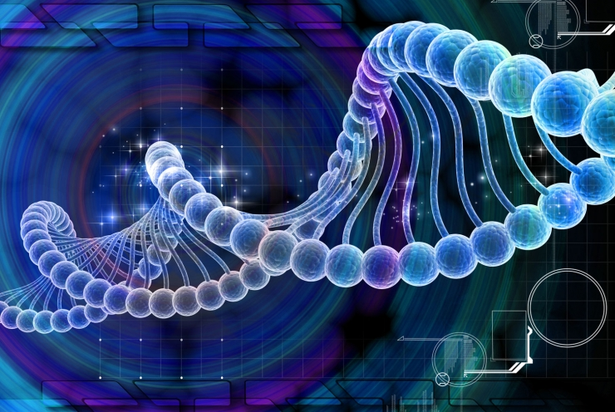
Computers Inside Biological Body
There are small sized computers that can operation within biological body
Scientists are trying to build the first truly biological computer made from the organic molecules of life
Capable of working within the living cells of organisms ranging from microbes to man
Transistors using DNA and RNA are built
Biological computers can be used to study and reprogram living systems, monitor environments and improve cellular therapeutics

Slide 14
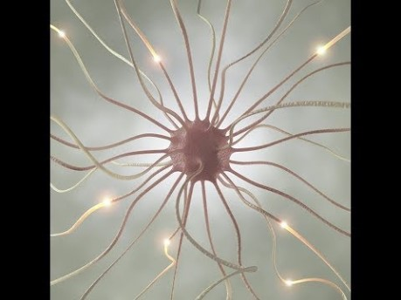
Biological Computers
Thanks to YouTube video provider

Slide 15
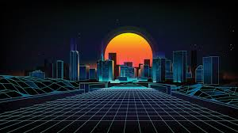

Future Computers
Nano-computing
Biological computing
Reverse engineering of human brain
Ultra intelligent machine
Human brain like processing
Quantum Computing
High speed chips

Slide 16



Thanks for watching
Dr. Sajid Iqbal
Assistant Professor
Department of Computer Science
Bahauddin Zakariya University, Multan
sajidiqbal.pk@gmail.com
https://github.com/sajjo79/Introduction-to-Computers
Allah Hafiz
COMEDXD

